Slide 1
Topic:Covid-19 Diagnosis Based On Symptoms Bijoy Kumar Dey A90555918017 BSTAT 6 NTCC Project

Slide 2
Introduction
The novel coronavirus disease caused by the SARS-CoV-2 continues to pose a critical and urgent threat of world. In this time we need such a process that can identify covid-19 positive patients very quickly. So Here we need such a model that use symptoms such as However, most previous models were based on data from hospitalized patients, thus are not effective in screening for COVID in the general population.

Slide 3
Objective
The classification goal is to predict that a patient is covid-19 positive or negative on the basis of his/her symptoms. Building a model which can fulfill the classification goal with more accuracy is the main objective of my project.

Slide 4
Dataset
The Israeli Ministry of Health publicly released data of all
individuals who were tested for SARS-CoV-2 via RT-PCR assay of a nasopharyngeal swab. This data contains total 1048576 observations and total 10 variables.

Slide 5
Methodology
Convert all categorical variables to the factor.
Fill all the missing values using method of imputation using logistic regression.
Split the data in train and test set.
Fit Decision tree and Xtreme Gradient Boosting model on the train dataset as all the variables are categorical variables and select a model among them by seeing the good accuracy rate. (But decision tree with good accuracy rate cannot be taken many times because decision tree model have a over fitting problem.)

Slide 6
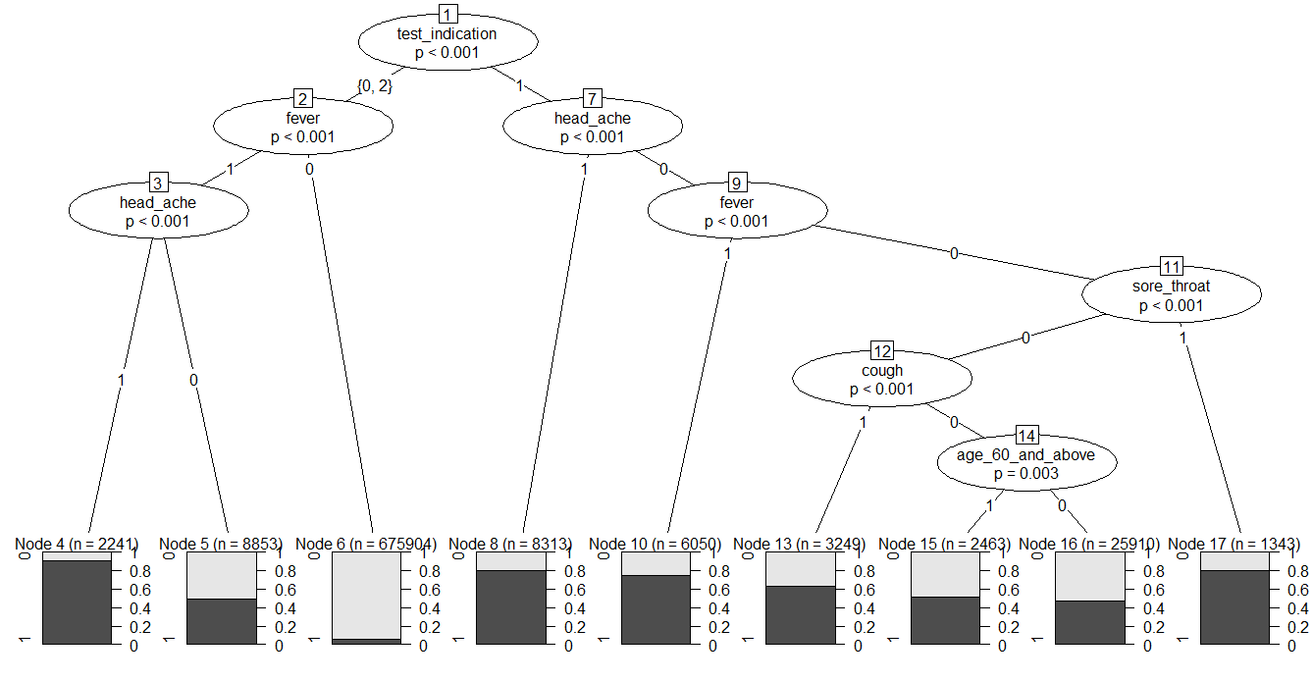
Results
Imputation method for missing value predict the missing values using logistic regression.
Split the dataset in 70:30 ratio and out of this 70% is for training dataset and 30% for test dataset.
Now I plot the Decision Tree on the train dataset. I got a decision tree in R :-

Slide 7
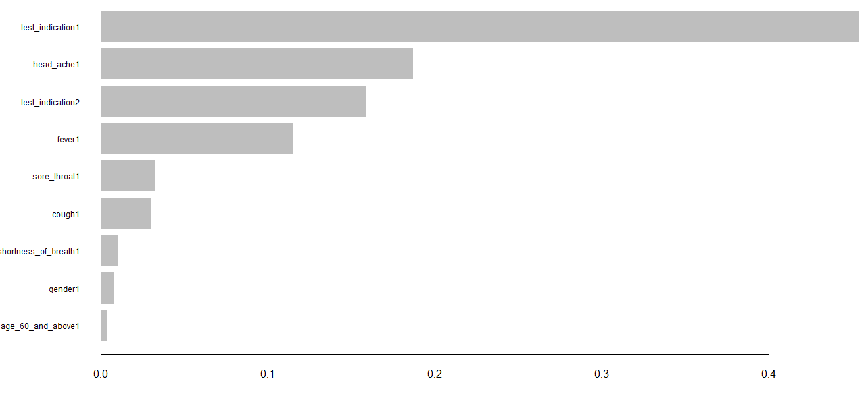
I fit another algorithm on this data and comparing this two I will decide which one I will choose. So I choose XGBOOST algorithm since it has so many advantages which I discuss before. Now for this I first convert all my dataset into matrix format since XGBOOST support only this format.
After converting this, I run This XGBOOST model on the train dataset with eta value 0.2, depth of the decision tree 6 and no. of iteration is 100. Then XGBOOST model give us a graph from which we can see which variable of the dataset are important:

Slide 8
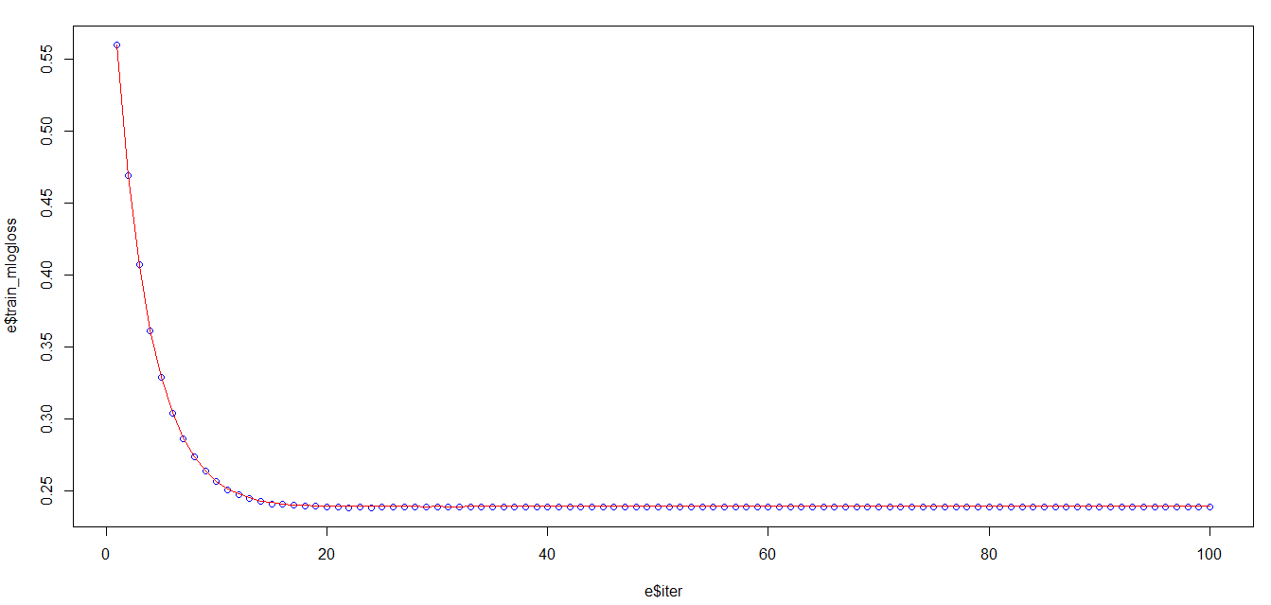
Here red curve fill the dots very well that means XGBOOST algorithm fit well.
Now A graph is drawn on Iteration vs. log loss and here I plot a scatter plot with blue color where I take the log loss on train data and draw a line on the same graph on log loss of the test data with red color. This graph says us that the model which is building on train data will fit on test data well or not. The graph is:

Slide 9


Discussion
This decision tree model, I predict the dependent variable and calculate the confusion matrix since this is a classification problem and I got the confusion matrix for train data like this:
Here accuracy rate is 91.5%. Formula of accuracy rate =
(True positive + true negative)/ (total observation). For Test dataset the confusion matrix of decision tree algorithm is:-
Here accuracy rate 91.47%.

Slide 10


The confusion matrix of train data of XGBOOST model is:
Here accuracy rate of the confusion matrix is 92.1241% and the confusion matrix of test data of XGBOOST model is:
Here accuracy rate of the confusion matrix is 92.12249%. After that I save the model in a .rds file so that anyone can run this model behind any app or data structure.

Slide 11
Conclusion
I have studied two models namely Xgboost and decision Tree and I choose here XGBOOST model as a perfect model for my project because first think Decision tree’s confusion matrix accuracy rate is less than XGBOOST confusion matrix accuracy rate. Secondly Decision tree has a over fitting problem so that sometime decision tree model run on the dataset with good accuracy rate but when we run this behind any data structure then it does not function well. Thirdly XGBOOST algorithm handles a bias dataset very well with good accuracy rate.
So I choose XGBOOST model as a best fitting model for my project and I save this in .rds file so that anyone can run this behind any data structure so easily.

Slide 12
References
https://data.gov.il/dataset/covid-19
https://www.kdnuggets.com/2017/09/missing-data-imputation-using-r.html
Introduction to Machine learning with R by Scott V. Burger
https://www.tutorialspoint.com/r/r_decision_tree.htm
https://www.analyticsvidhya.com/blog/2016/01/xgboost-algorithm-easy-steps/

Slide 13
THANK YOU

